Slide 1
On Learning Meaningful Code Changes
via Neural Machine Translation
2019 IEEE/ACM 41st International Conference on Software Engineering (ICSE)
Michele Tufano∗, Jevgenija Pantiuchina†, Cody Watson∗, Gabriele Bavota†, Denys Poshyvanyk∗
2020-02-12
JuHyoung Kim
kjhkjh75@naver.com

Slide 2
-INTRODUCTION
Rise of this research thread ( code completion, generation of commit messages, method names, code comments, defect prediction, bug localization and fixing , clone detection, code search) in the software engineering community is due to combination of factors.
The first is the vast availability of data, specifically source code, and its surrounding artifacts in open-source repositories.
DL has become a useful tool due to its ability to learn categorization of data through the hidden layer architecture, making it especially proficient in feature detection.
- Neural Machine Translation has become a premier method
3. Availability of cheap hardware able to efficiently run DL infrastructures

Slide 3
-INTRODUCTION
- A few approaches have been proposed to automate non-trivial coding activities.
Make the first empirical step towards extensively investigating the ability of an NMT model to learn how to automatically apply code changes just as developers do in PRs.

Slide 4
-INTRODUCTION
Mine three large gerrit code review repositories, Android, Google Source and Ovirt
Only considered ‘merged’ and ‘reviewed’ PR for three reasons.
1. To ensure that an NMT model is learning meaningful changes, justifying the choice of mining “reviewed PRs”
2. To analyze the discussions carried out in the code review process to
better understand the types of changes learned by our approach.
3. Only focus on merged PRs, since the code before and after the PR is available

Slide 5
-APPROACH
Starts with mining PRs from three large gerrit repositories.
Extraction
Abstracted, filtered, and organized in datasets.
Training
Concretization

Slide 6
-APPROACH
Code Reviews Mining
- Built a gerrit crawler to collect the PR data
- The crawler extract the list of projects hosted on it.
- The crawler retrieves the list of all PRs submitted for review and
having “merged” as the final status
- Process each merged PR P using the following steps.
1) Define the set of Java files submitted in P as Fs={F1,F2,F3,…,Fn}
2) For each file in Fs, Use the Gerrit API to retrieve their version
before the changes implemented in the PR
3)Gerrit API is used to retrieve the merged file versions impacted
by the PR.
End of the mining process obtain three datasets of PRs
PRovirt,PRandroid,PRgoogle.

Slide 7
-APPROACH
2. Code Extraction.
Each mined PR is represented as pr = {(f1,….,fn),(f`1,…,f`m)}
f1,…,fn. = before the PR f`1,….,f`m = after the PR
Using gumTreeDiff to establish the file-to-file mapping
performed using semantic anchors, between pre and post PR files

Slide 8
-APPROACH
3. Code Abstraction & Filtering
- NMT models generate sequence of tokens by computing probability distribution over words.
- The problem of large vocabularies (a.k.a. open vocabulary) = NLP field,
even more pronounced for source code than languages.
- To allow the training of an NMT model, reduce the vocabulary
1) several chunks of code might remain untouched
2) developers tend to reuse identifiers and literals already present
in code.
3) frequent identifiers and literals are likely to be introduced in
code changes.

Slide 9
-APPROACH
3. Code Abstraction & Filtering
- Start by computing the top-300 most frequent identifers and literals
- Each unique identifier and literal is mapped to an ID,
having the form of CATEGORY_#, (TYPE, METHOD,VAR…)
- The mapping between IDs and actual identifier/literal values is saved in a map M, which allows us to map back the IDs
- replace all identifiers/literals with IDs, except for the list of 300 most
frequent identifiers and literals

Slide 10
-APPROACH
4. Learning Code Transformations
- Describe the NMT models we use to learn code transformations.
- RNN Encoder-Decoder : RNN architecture with attention mechanism.
1) P(ama|amb) = P(y1,….,ym|x1,…,xn), m and n may differ.
2) Adopt a bi-directional RNN.
3) attention mechanism
- Beam Search Decoding : multiple possible translation.
- Hyperparameter Search : tested ten configurations of the encoder-decoder
architecture with different combinations of RNN Cells,
number of layers and units.

Slide 11
-APPROACH
5. Code Concretization
- Abstracted code generated as output by the NMT model is concretized by
mapping back all the identifiers and literal IDs to their actual values.

Slide 12
STUDY DESIGN
RQ1 : Can Neural Machine Translation be employed to learn meaningful code changes?
    RQ2 : What types of meaningful code changes can be performed by the model?

Slide 13
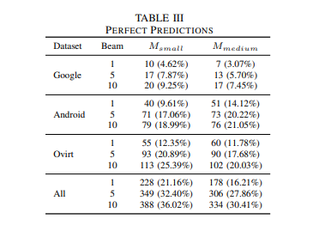
STUDY RESULT
RQ1
- NMT models are able to learn meaningful code changes and perfectly
predict code transformations in up to 21%.
and up to 36% when 10 possible guesses are generated.

Slide 14
STUDY RESULT
RQ2
Bug fix : Add try block, add null check, modify if condition..etc
Refactoring : Readability, Naming, encapsulation.
Other : Type , initialization, add code, delete code

Slide 15
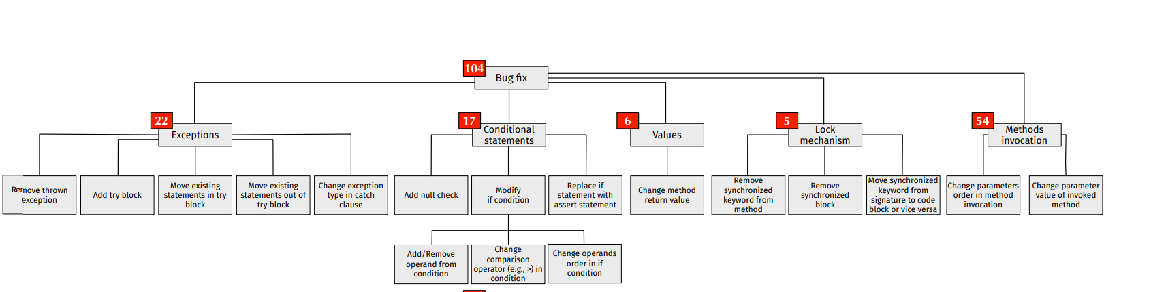
STUDY RESULT

Slide 16
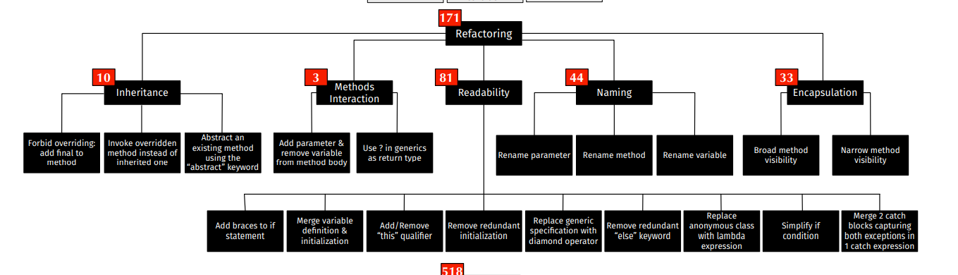
STUDY RESULT

Slide 17
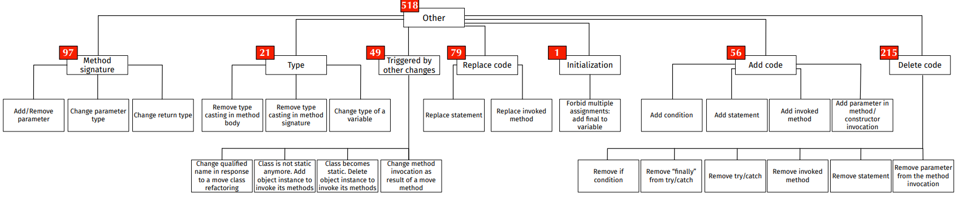
STUDY RESULT

Slide 18
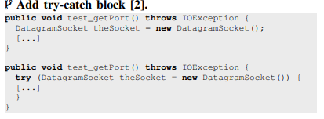
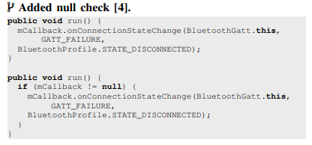
EXAMPLE

Slide 19
THREATS TO VALIDITY
Construct validity
- code components before and after PR through a crawler relying on the
Gerrit API. The crawler has been extensively tested, and the manual analysis of the extracted pairs performed to define the taxonomy.
Internal validity
- The performance of the NMT model might be influenced by the hyperparameter configuration we adopted.
As in any manual process, errors are possible, and we cannot exclude the
presence of misclassified code transformations in our taxonomy.
External validity
- only focusing on Java and less than 100 tokens
our results might not generalize to other projects/languages.

Slide 20
Future work
For improvement of learning model.
- Convolutional Sequence to Sequence Learning
By facebook
For prevent overfitting problem.
- Classify the bug category using code similarity.

